Slide 1
PRODUCTION TECHNOLOGY
(A8315)
Dr. S.ANANTH
PROFESSOR
DEPARTMENT OF MECHANICAL ENGINEERING
VARDHAMAN COLLEGE OF ENGINEERING
HYDERABAD

Slide 2
UNIT-III
HOT WORKING AND COLD WORKING

Slide 3
A8315 - Production Technology Course Outcomes (COs)
After the completion of the course, the student will be able to:
A8315.1. Explain the process of making patterns, preparation of sand mould, various special casting processes and casting defects.
A8315.2. Select appropriate Joining methods to joinWork pieces by using different welding techniques.
A8315.3. Identify various metal forming processes for the various applications.
A8315.4. Describe the properties and bonding techniques of plastics by using plastic molding techniques.
A8315.5. Illustrate the various non-destructive testing methods for a specific application

Slide 4
UNIT III-Course Syllabus
SEE QP 4 (a) Strain hardening, recovery, recrystallisation and grain growth, Comparison of hot working and cold working. Rolling: Theory of rolling, types of Rolling mills, rolling defects
SEE QP 4 (b) Drawing: wire drawing and Tube drawing, Forging: Types of forging, forging defects. Sheet metal operations. Forces and power requirements in the above processes

Slide 5

Cha ter-3/2
METAL WORKING PROCESSES

Slide 6
Definition
Metal Working/Mechanical Working/Metal Formïng Processes

Slide 7
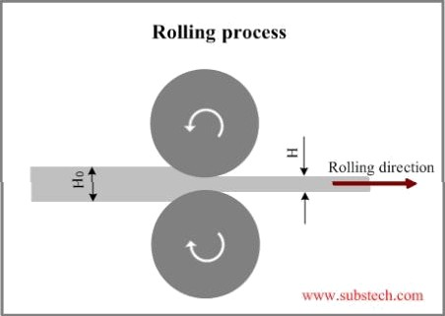
Definition
The process in which permanent change is obtained in a metal shape by plastic deformation
under the action
of external forces.

Slide 8
Why Metal Forming is required?
Economical and time saving process to obtain desired shape from the given material.
To improve mechanical properties.
To minimize defects such as holes, cracks etc
To distribute impurities equally in metal.

Slide 9

Classification of
etal Working
Hot Working of metals.
Cold Working of metals.

Slide 10
ot Working of metal

Slide 11
Definition
It can be defined as the plastic deformation of metals and alloys at a temperature above recrystallisation and below melting point such that fine refined grain is obtained.
Maximum working temperature is 0.7 to 0.9
times the melting point.

Slide 12
Advantages
Properties such as strength, ductility and toughness is improved.
Density increases by removing voids.
Desired shape can be easily obtained under plastic deformation.
Effect of impurities can be reduced.
Good grain structure.
Atoms in same direction leads to better strength.

Slide 13
Disadvantages
Surface finish is not good.
Required accuracy is not obtained.
Process takes place at higher temperature, so
tool life is minimum.
Thus handling cost is high.

Slide 14

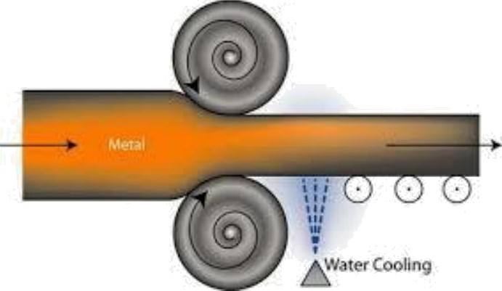
Hot working Methods
Hot Rolling

Slide 15
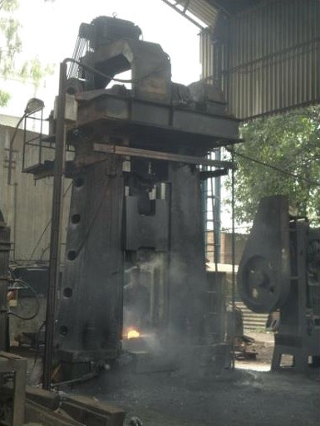
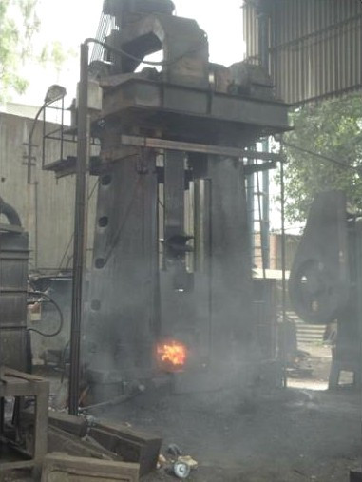
ot working Methods
Hot Forging

Slide 16

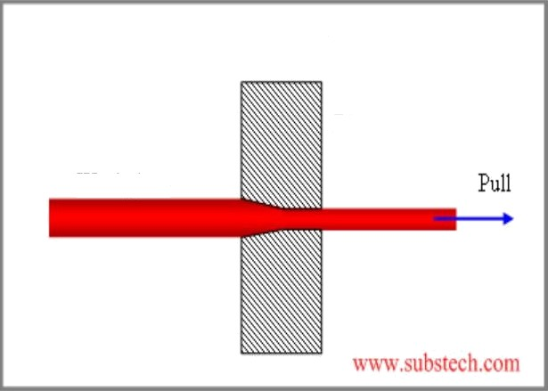
ot working
ethods
Hot Drawing
Drawing
Die

Slide 17
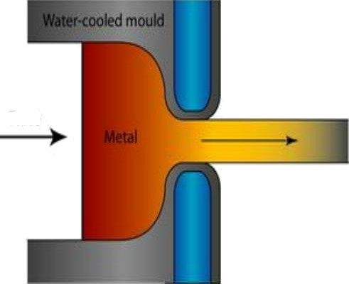
ot working
ethods
Hot Extrusion
forte

Slide 18
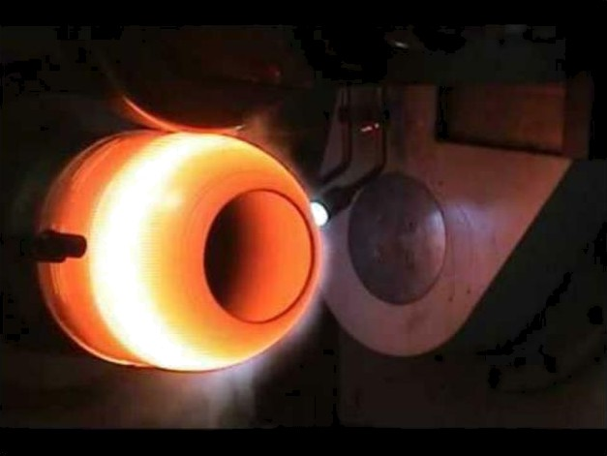
ot working
ethods
Hot Spinning

Slide 19
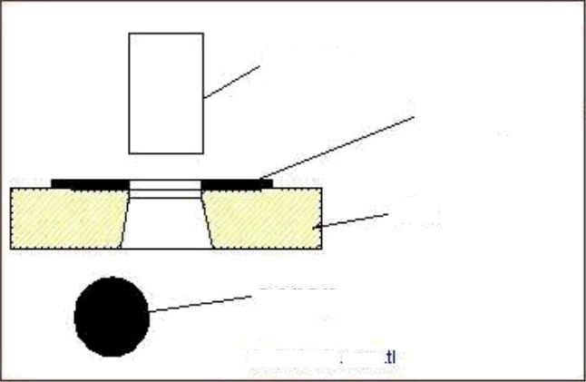
ot working
ethods
Hot Piercing
punch
work piece
die
scrap
designtools page

Slide 20


Col Working of
etals
Melting Point
Hot Working of metal
Recr stallization tern erature
Cold Working of metal
Normal Temperature
Temp Rise

Slide 21
Definition
The process in which plastic (permanent) deformation occurs when the process is carried out at a temperature lower than recrystallisation temperature.
The temperature is half of absolute melting
temp.
Theoretically, it is room temperature. (25 to
30 “C)

Slide 22
Advantages
Improves hardness and strength
Desired accuracy is possible.
Heating is not required.
Thus, cost and time is reduced.

Slide 23
Disadvantages
Reduces ductility, thus difficult to process.
Force required is more.
Produce internal and residual stresses.
Atoms are deformed.
Low ductility -> Difficult to process.
Cost increases.

Slide 24

Cold working
ethods
Cold Rolling
° Cold Drawing
° Cold Extrusion
° Cold Spinning
Squeezing
Bending
Peening
° Coining
° Hobbing

Slide 25
Difference between Hot and Cold
Working
Hot Working Cold Working
1. Process is done above | 1. | Below recrystallisation
recrystallization |  | temperature.
temperature
2. Process is done on hot metal. | 2. | Process is done on metaI's at room
3. Less force is required. |  | temperature.
4. No residual stress is | 3. | More force is required.
formed in the metal. | 4. | Residual stresses
formed is more.

Slide 26
Difference between Hot and Cold
Working
Hot Working Cold Working
5. Improves ductility, | 5. | Improves strength and
stiffness and |  | hardness.
toughness.
Accuracy in surface finish is less.
Maintenance cost is
high.
Accuracy in surface finish is more.
Maintenance cost is
low.

Slide 27
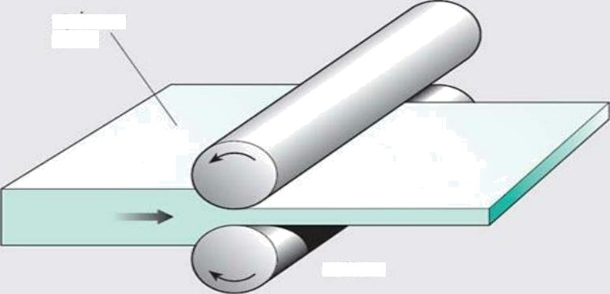

Rolling Process
plate
rc›IIers

Slide 28
Definition
Rolling process is the process in which the metals and alloys are plastically deformed by passing them between circular or cylindrical rollers.

Slide 29
What actually happens in Rolling Process????
Rolls or rollers are arranged.
The metal piece which is to be deformed is drawn between the space of the rollers (by using frictional force between the rolls and metal surface)
Metal is squeezed (compressive force)

Slide 30
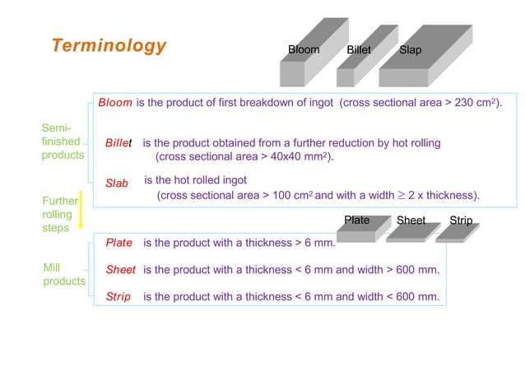

Slide 31
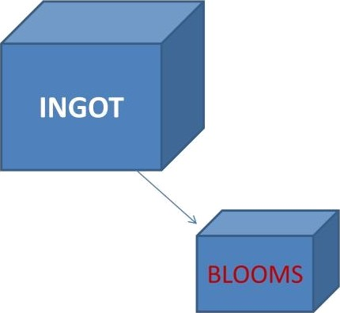



ROLLING PROCESS
Plates

Slide 32
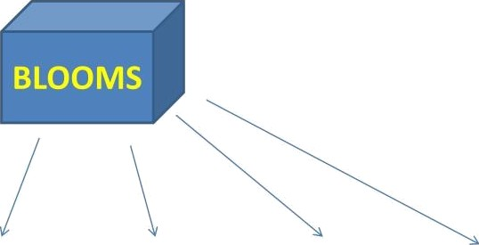
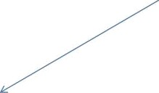
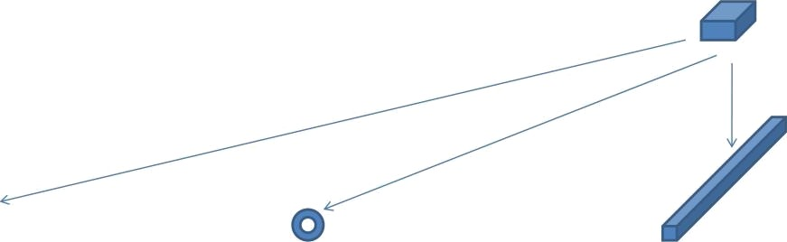

Rounds
Channels
I-Beams
Rails
Billets
Rods
Wires
Bars

Slide 33
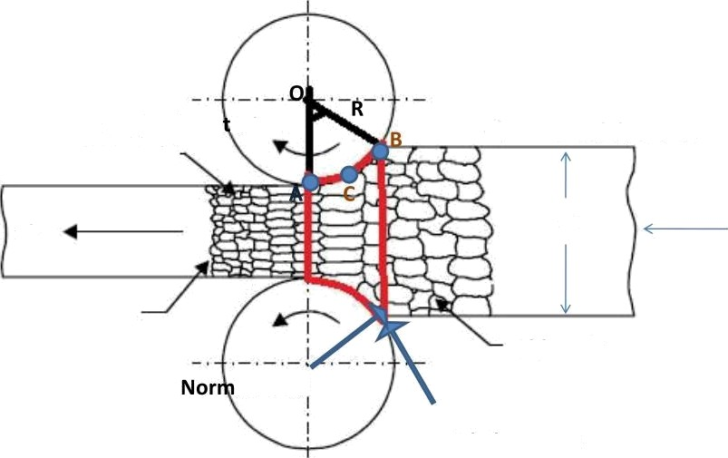
Angle of Contact
Angle of con act
New grain
Feed direction
V2
t2
t1
V1
Old Grain
al Force
Friction Force

Slide 34
Angle of Contact
From the fig. we can say that, when the roller and work piece make contact, then we get arc AB.
Here arc AB is the contact portion.
Now, arc AB makes an angle “Ɵ” with 0.
This angle formed is known as angle of
contact.

Slide 35
Angle of bite: Extent of thickness reduction during rolling Factors influence Angle of bite: 1. Condition in which the rolling is carried out(hot/cold rolling). 2. Surface roughness of rollers smooth rollers – low AOB rough rollers - high AOB 3.influenced by diameter of rollers larger dia – low AOB smaller dia – high AOB for hot rolling process AOB=24° - 32° for cold rolling process AOB= 3-4°

Slide 36
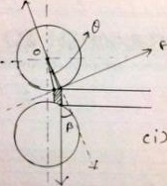
Princi e working of Rolling
Stage 1: At the beginning, the metal enters smoothly and it should not come back from roller.
For that, 0f Ɵ *

Slide 37
Stage 2:
Between B and C, speed of work piece is less than roller speed
° Stage 3: At point C, the speed of work piece and roller is same. This point is known as no slip point.
° Stage 4: From point C to A, the speed of work
piece is more than the roller
° i.e. V2 Z' V 3 Ve

Slide 38
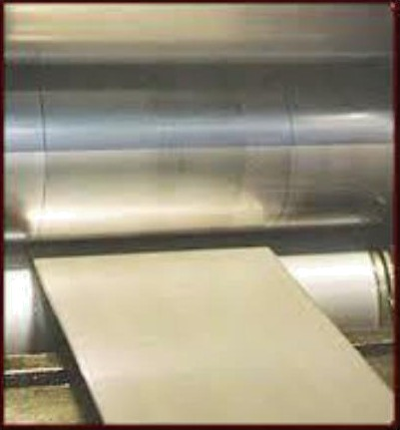
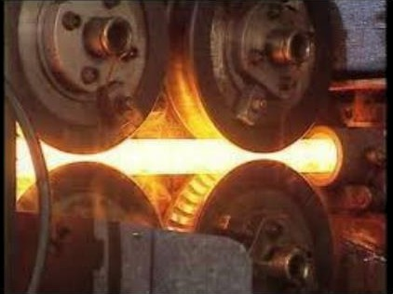
Types of Rolling
Hot Rolling
Cold Rolling

Slide 39
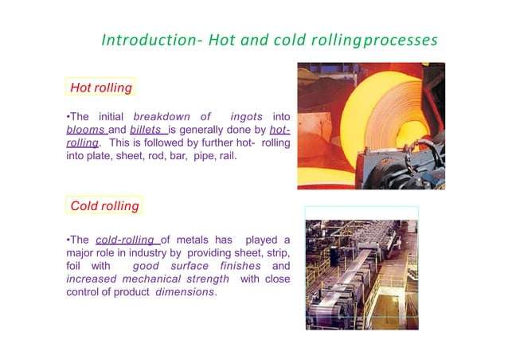

Slide 40

Roll
ills used in Rolling Process:
Two high rolling mill
2 high pull over mill
2 high reversing mill
Three high rolling mill
Four high rolling mill
Cluster rolling mill
Continuous rolling mill
Special mill

Slide 41
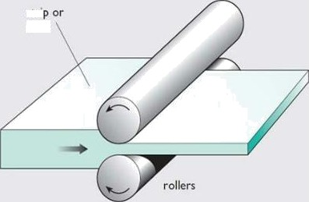
Two igh Rolling mills
2- High Pull Rolling Mill
In this type of rolling mill, the direction of feed is from one side only.
It uses two rollers.
i.e when the first pass is over, the work piece is again brought back to its original position and the rolled back again, which lesser space between the rollers.
s‹ri
pla‹e

Slide 42
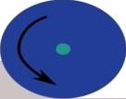
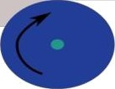
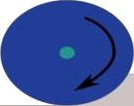
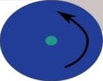
Two igh Rolling mills
Two High Reversing Mill
In this method of rolling, the direction of feed is from both direction.
Here also, 2 mills are used.
During this process, handling of work piece is easier.
(1)
(2)

Slide 43
Two igh Rolling mills
Two high rolling mills are used for bloom,
billet or slab rolling.
Two high roll mills are normally used for obtaining medium change in cross section.
For every pass in reverse mill, the direction of
roller is to be changed.

Slide 44
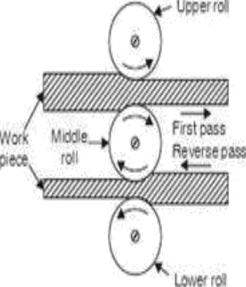
Three igh Rolling mills
Here total three rollers are used. Upper, middle and lower roller.
As shown in figure, we can easily see that the gap between upper roll and middle roll is more compared to middle and lower roll.

Slide 45


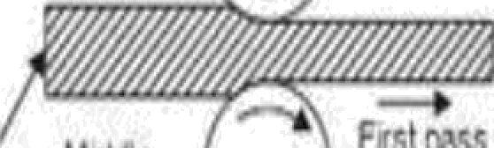

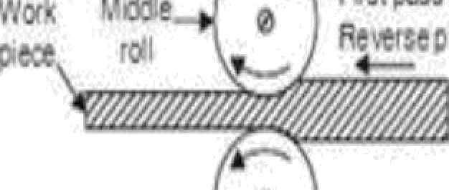


Three High Rolling mills
The reason for this is, initially, the ingot or bloom is fed between upper and middle roll to decrease the cross section.
Thereafter, in the reverse pass, the work piece is passed between middle and lower roller to further decrease its cross section.

Slide 46
Three igh Rolling mills
In this process, there is no need to change the
direction of roller.
Thus, minimum power is required.
Bloom, billet, channel, rail can be manufactured.
It is cheaper.

Slide 47

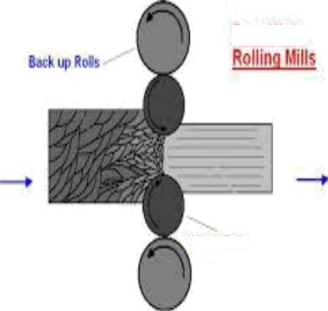
Four igh Rolling
ills
Here total four rolls are used, of which two are bigger rolls and two smaller ones.
Friar 8i@
The bigger rolls are known as back up rolls.
The smaller rolls are
known as working rolls.
'f'/0f#. # Oily

Slide 48
Four igh Rolling
ills
Here, metal with bigger size are rolled by passing them between the working (smaller) rolls.
Since, these rolls are used to roll bigger sizes metals, they have to face shocks and vibrations.
F o u r H i g h
',•›,„e

Slide 49

Four igh Rolling
ills
Also, huge amount of
pressure is to be applied.
For this purpose, back up rolls (bigger rolls) are used.
The work piece can be entered between the rolls in both direction by changing the roll direction and space between the working rolls.
Friar 8i@

Slide 50


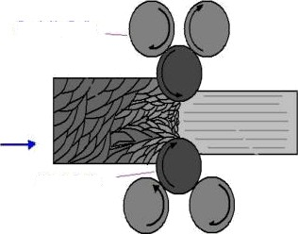
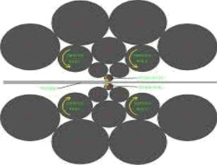
uster Rolling ill
Back Up Rolls
As from the figures, we can say cluster mills are the type of rolling mills, which has 6 or more rolling mills in operation.
It is used for cold
working of metals.
Work Rolls
Cluster Rollinq uills
Srx DzI>1IR THLU

Slide 51
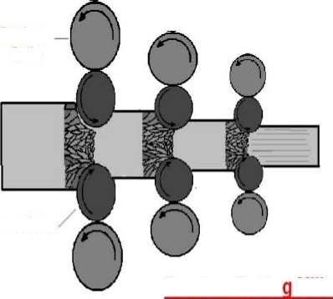
Continuous (Tandom
Rolling ill)
Its arrangement is similar to two — high rolling mill.
Here, the metal work piece passes from one roll pass to another anc we get continuous reduction in size.
Used for mass
production.
Back up Rolls
W0r# g0llS
Tahdom Rollin
Mills

Slide 52
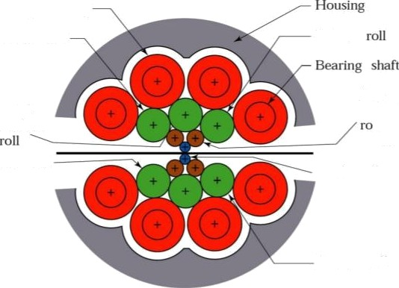



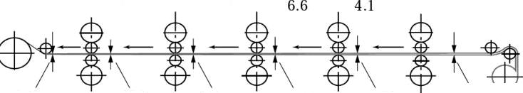
Schematic illustration of various roll arrangements: (a) two-high;
(b) three- high; (c) four-high; (d) cluster (Sendzimir) mill (e) Tandom rolling mill.
(d)
Backing bearing
Driven roll
Driven
(a)
(c)
First inierm diate
11
Secoixl intermediate
Strip
roll
Driven roll
Work
Driven roli
Stand 1
30
2
4
5
17.7
10.7
mls
reel i
Take—up
Pay-off
reel
,
2.25
0.26
0.34
0.56 ” 0.90
1.45

Slide 53

Special ill
Nowadays, usage of special type of rolling
mills are increasing in industries at higher rate.
There are main two types of Special Rolling Mill. They are as follows
Universal Rolling Mill Planetary Rolling Mill

Slide 54

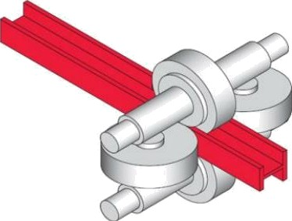
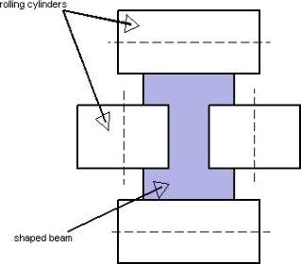

niversal Rolling ill
In this type of rolling mill there are two vertical rolling mills, and two horizontal rolling mills.
This mill generally produces H-section and I-section.
This mills are used for producing accurate edges.

Slide 55


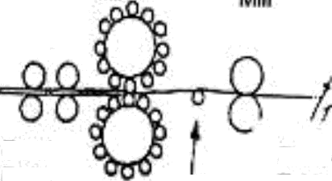
Panetary Rolling ill
Here the rolls are arranged in the shape of sun and planets, thus its named as planetary rolls.(only for understanding)
The feed rolls, push the metal into the gap between the planetary rolls.
PlarBtay
Mill
Fead
^{R}”’*
Rao
Table
'
Tendon
Rol

Slide 56

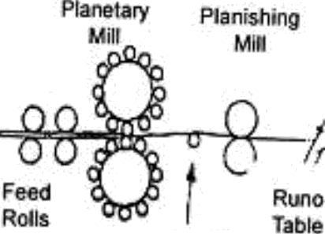
Planeta
Rolling ill
Further after rolling from planetary rolls, the work piece will pass through two or, four high mill.
The product obtained is in form of strips.
Tension
Rol

Slide 57
DEFECTS AND ITS REASON FOR CAUSE
1. Cracks 1.
Cracks mainly occur due to cold working of metals.
2. Rough surface is formed due to oxidation in hot working process.
2. Rough Surface

Slide 58
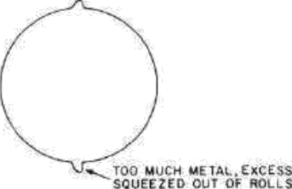
DEFECTS AND ITS REASON FOR CAUSE
Fin
Lap
Excess material pass during rolling.
Over filling at roll pass.

Slide 59
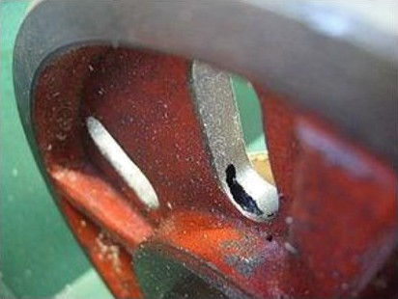
DEFECTS AND ITS REASON FOR CAUSE
Non uniform
deformation.
Blow holes, pit holes.
Due to unequal shape.
Gas inside the metal mould.

Slide 60

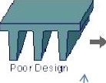
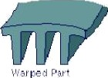
DEFECTS AND ITS REASON FOR CAUSE
7. Pipes
Due to uneven cooling.
8. Warpage
8. Due to uneven cooling and residual stresses.

Slide 61
Basic Elements of Rolling Mill
Rolls
•’Main components of rolling process.
•’It is rolled and gives shape to the metal.
•"Two types of rolls are used, (1) Working (2) Back
up rolls.
•^ Working rolls contact with work piece.
•’WhiIe Back up rolls provide strength to working rolls, do minimize deflection and add up force.

Slide 62


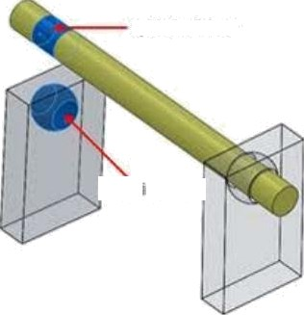


Basic
lements of Rolling ill
Bearin
and Housin •
They provide support
to the rollers shaft.
The rollers shaft are fixed at both the endings by bearings and housing for proper alignment.
If not, the product will
be defective.

Slide 63
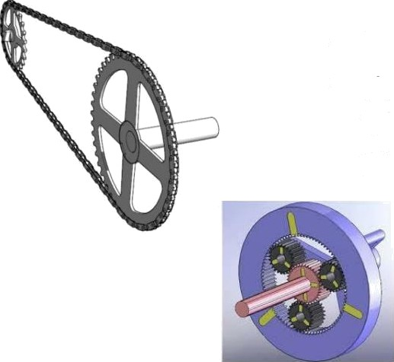
Basic
Elements of Rolling ill
Drive
Drives are of two types
Chain Drive
Gear drive
These drives are used to roll the rollers in rolling process

Slide 64
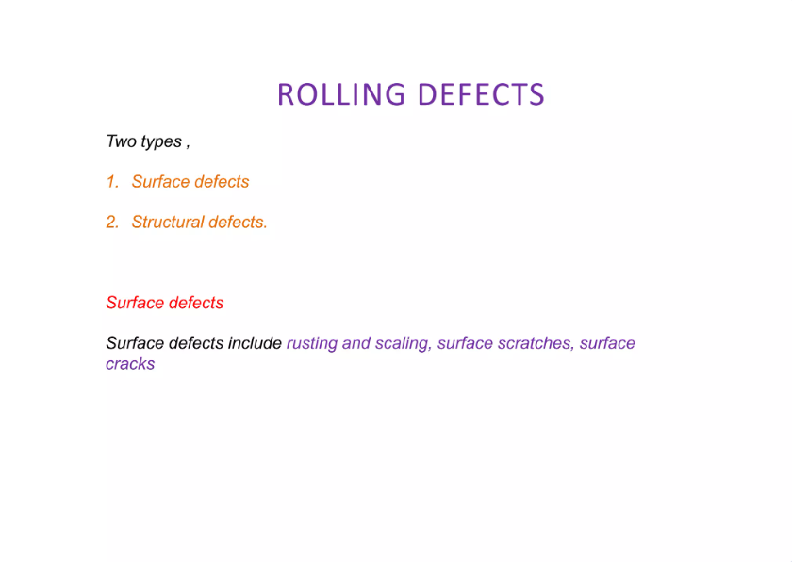

Slide 65
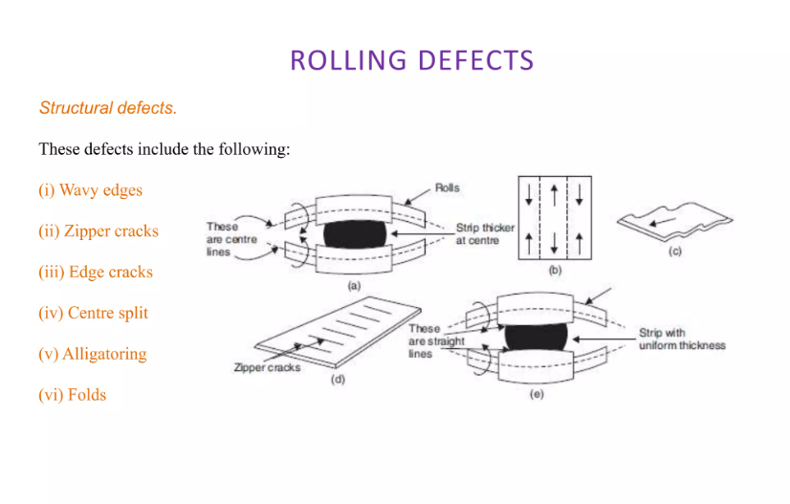

Slide 66
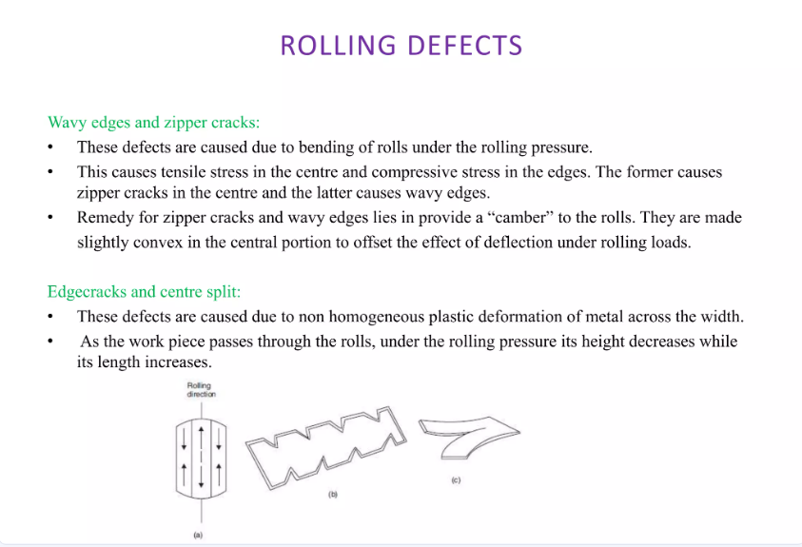

Slide 67
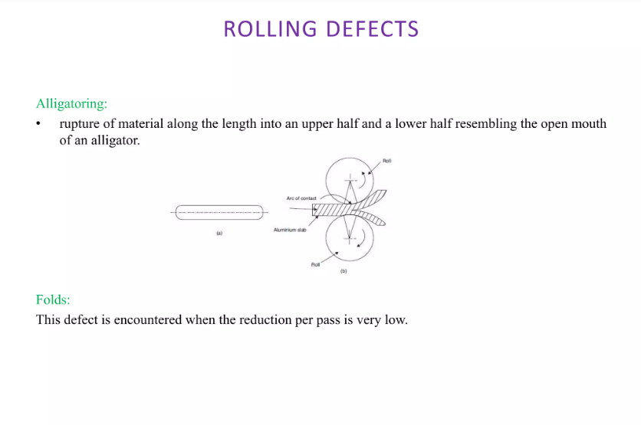

Slide 68
Forces and power requirement in rolling process:
This force depends on various factors such as:
Material properties of the workpiece (Yield strength, Hardness)
Friction between the rolls and the material
Reduction in thickness
Roll diameter

Slide 69
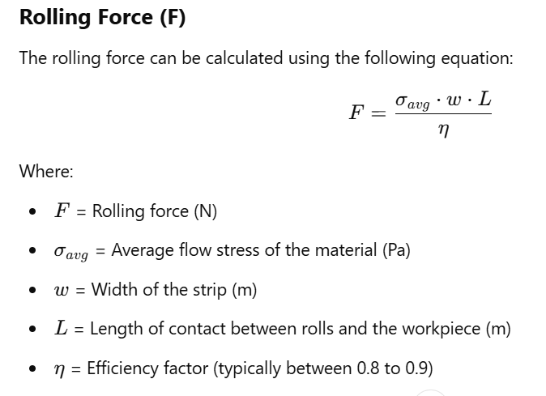

Slide 70
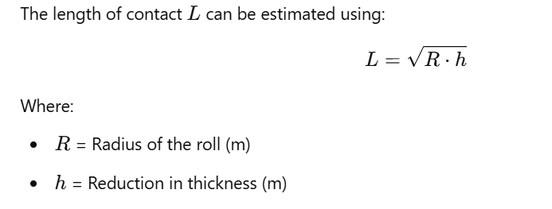
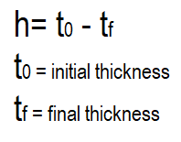



Slide 71



